Slide 1
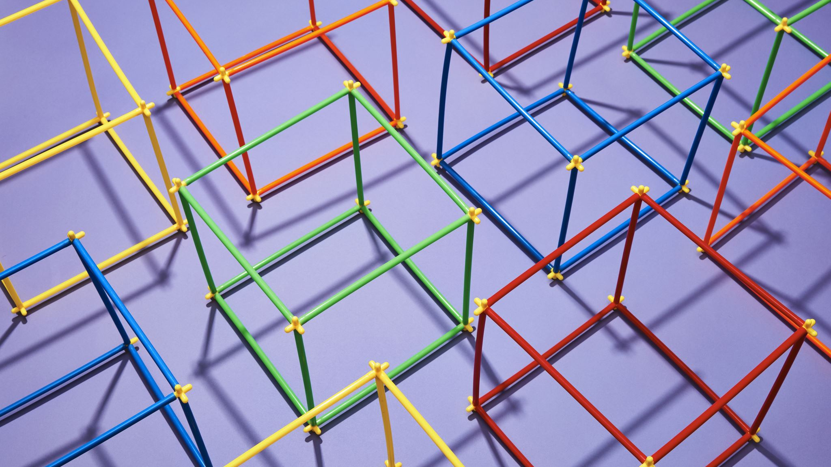
FAKE PRODUCT IDENTIFICATION SYSTEM USING BLOCKCHAIN TECHNOLOGY

Slide 2
ASBTARCT
In recent years, Counterfeit products play an important role in product manufacturing industries.
This affects the companies name, sales, and profit of the companies. Blockchain technology is used to identification of real products and detects fake products.
Blockchain technology is the distributed, decentralized, and digital ledger that stores transactional information in the form of blocks in many databases which is connected with the chains. Blockchain technology is secure technology therefore any block cannot be changed or hacked.
By using Blockchain technology, customers or users do not need to rely on third-party users for confirmation of product safety.
In this project, with emerging trends in mobile and wireless technology, Quick Response (QR) codes provide a robust technique to fight the practice of counterfeiting the products. counterfeit products are detected using a QR code scanner, where a QR code of the product is linked to a Blockchain.

Slide 3
INTRODUCTION
The global development of a product or technology always comes with risk factors such as counterfeiting and duplication, which can affect the company's name, company revenue, and customer health.
There are so many products that exist in the supply chain. To ensure that the product is real or fake.
Because of counterfeit or fake products manufacturers facing the biggest problem and huge losses.
To find the genuineness of the product we can use blockchain technology.
Blockchain is an arrangement of recording information that makes it troublesome or hard to change, hack, or cheat the framework.

Slide 4

PROBLEM STATEMENT
Every popular brand has fake manufacturers selling a counterfeit item with misleading and invalid labels, which are sold at cheaper rates. Even the company experts may not be able to distinguish between counterfeit and original items.

Slide 5
SOLUTION FOR THE PROBLEM
If the original manufacturer embeds a QR code on the product that is linked to the blockchain system, one could scan the QR code which would tell whether the product is fake or not.
Suppose we come across a counterfeit item - we need to be able to identify that it is indeed fake through its QR code, verified across a blockchain. A hacker attempting to add said counterfeit QR through the blockchain must find it impossible to modify the chain.

Slide 6
OUR SOLUTION
Each product has a blockchain and each block in the blockchain will have a set of transactions that are associated with the product.
Each block will consist of -
an unique index (to differentiate between transactions)
timestamp (when the block was created)
verification code
proof
set of transactions

Slide 7
OUR SOLUTION
Suppose a person wants to buy a specific product. They must:
Verify the QR code of the product with the blockchain to verify the product's validity,
Insert the transaction data into a block while checking against it with the proof/nonce,
Wait for the block to be verified across all the decentralized database so it can be inserted into the blockchain.
Additionally, the blockchain must be resilient to attacks and modifications to the product list by unknown sources.

Slide 8
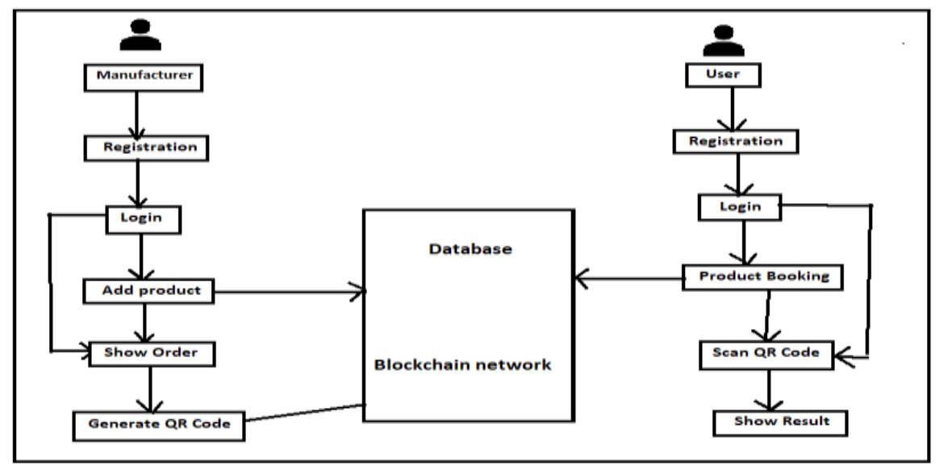
ARCHITECTURE

Slide 9
IMPLEMENTATION
We have implemented the blockchain class for our solution in Python
The class contains implementations for some of the methods:
create_block() - inserting a block into the blockchain
pow() - proof of work as per the assignment
hash() - method for encoding the block
We will be implementing a method called transaction_verification() - blocks need to be verified using the ZKP (Zero Knowledge Proof) before they can be added to the chain
We will also be implementing the method view_user() as per the assignment

Slide 10
SYSTEM REQUIREMENTS
Software Requirements:
Front End – Anaconda IDE
Backend – SQL
Language – Python 3.8
Hardware Requirements:
•Hard Disk: Greater than 500 GB
•RAM: Greater than 4 GB
•Processor: I3 and Above

Slide 11
CONCLUSION
As a result, the suggested method can help end users detect bogus items in the business logistics.
By scanning the QR code, users can obtain information about transactions and the current owner of an item, helping them to determine whether it is legitimate or not.
We will create a system that manages and monitors product transportation information in the future.

Slide 12
REFERENCE
[1] Satoshi Nakamoto, ―Bitcoin: A Peer-to-Peer Electronic Cash System‖, 2008
[2] Hyperledger, ―Hyperledger Blockchain Performance Metrics‖, V1.01, October 2018
[3] R.C. Merkle, "Protocols for public key cryptosystems," In Proc. 1980 Symposium on Security and Privacy, IEEE Computer Society, pages 122-133, April 1980.
[4] Armin Ronacher, ―Flask Docs‖, http://flask.pocoo.org/docs/‖
[5] G. Wood, ‗‗Ethereum: A secure decentralised generalized transaction ledger,‘‘ Tech. Rep., 2014.
[6] OECD (2016), Illicit Trade: Converging Criminal Networks, OECD Reviews of Risk Management Policies, OECD Publishing, Paris, https://doi.org/10.1787/9789264251847-en.
[7] M. Castro and B. Liskov, ‗‗Practical byzantine fault tolerance and proactive recovery,‘‘ ACM Trans. Comput. Syst., vol. 20, no. 4, pp. 398– 461, Nov. 2002.

